Slide 1
Emotion detection
COGNITIVE ANALYTICS PROJECT

Slide 2
Problem Statement
In today's digital age, businesses and organizations have access to an enormous amount of text data in the form of social media posts, customer feedback, reviews, and other online content. However, understanding the emotions and sentiments expressed in this text data is a major challenge. Manual analysis of such large volumes of text is time-consuming, error-prone, and not scalable. Therefore, there is a need for automated tools and techniques that can accurately and efficiently analyze the emotional tone and attitude expressed in text data.

Slide 3
Abstract
In this project, we propose to develop an emotion detection system using machine learning algorithms and natural language processing techniques. Our system will leverage existing datasets of sentiment-bearing words and phrases, as well as develop its own models through supervised learning on annotated data. The goal of our system is to accurately identify the emotional tone of a piece of text, whether it is positive, negative, or neutral, and provide valuable insights into people's opinions and attitudes towards a particular topic or product.

Slide 4
Introduction
Sentiment analysis in text, also known as opinion mining, is a natural language processing technique that involves the use of machine learning algorithms and statistical models to identify and extract subjective information from text. The goal of sentiment analysis is to determine the emotional tone or attitude expressed in a piece of text, whether it is positive, negative, or neutral.

Slide 5
Cognition in “Feeling Words”
Cognition plays a critical role in text analysis, which involves the use of computational techniques to analyze and understand human language. Cognition refers to the mental processes involved in understanding and interpreting language, including perception, attention, memory, and reasoning. In text analysis, cognition is used to extract meaningful information from text data, including emotions, sentiments, opinions, and other semantic structures.

Slide 6
Cognition Application in the project
Overall, cognition plays a critical role in sentiment analysis in text by enabling accurate and efficient analysis of the emotional tone and attitude expressed in text data. By leveraging cognitive techniques such as NLP and machine learning, sentiment analysis can provide businesses and organizations with valuable insights into people's emotions and attitudes towards a particular topic or product

Slide 7
Workflow
Data Collection & Preprocessing
Sentiment Analysis
Collect textual data and Images
Using flair & VADER extraction of emotion in text and also in face
1
2
3
4
Feature Extraction
Evaluation & Visualisation
Bag-of-words, n-grams, word embedding
Visualize the results

Slide 8
Techstack
Prog. languages
Libraries
Framework
Others
Python
Textblob
PIL
Vader, Flair
Streamlit
Tensorflow
NLTK
VSC

Slide 9
VADER
VADER Sentiment Analysis. VADER (Valence Aware Dictionary and sEntiment Reasoner) is a lexicon and rule-based sentiment analysis tool that is specifically attuned to sentiments expressed in social media, and works well on texts from other domains.
FLAIR
A powerful NLP library. Flair allows you to apply our state-of-the-art natural language processing (NLP) models to your text, such as named entity recognition (NER), sentiment analysis, part-of-speech tagging (PoS), special support for biomedical data, sense disambiguation and classification, with support for a rapidly growing number of languages.
A text embedding library. Flair has simple interfaces that allow you to use and combine different word and document embeddings, including our proposed Flair embeddings and various transformers.

Slide 10
Results!

Slide 11
Emotion in Text

Slide 12
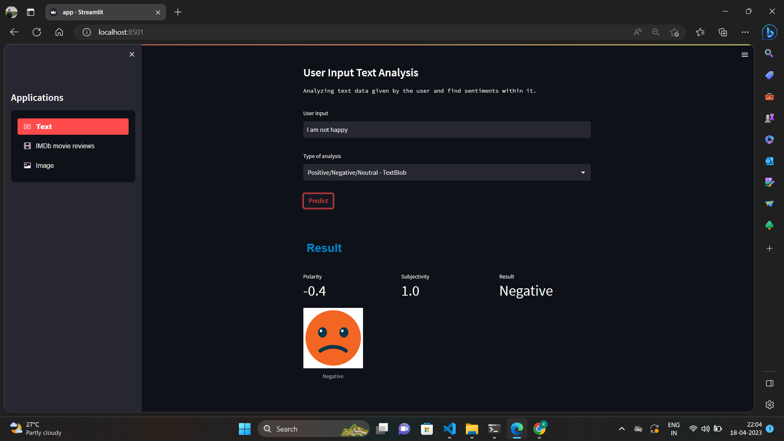

Slide 13
Emotion in Image

Slide 14
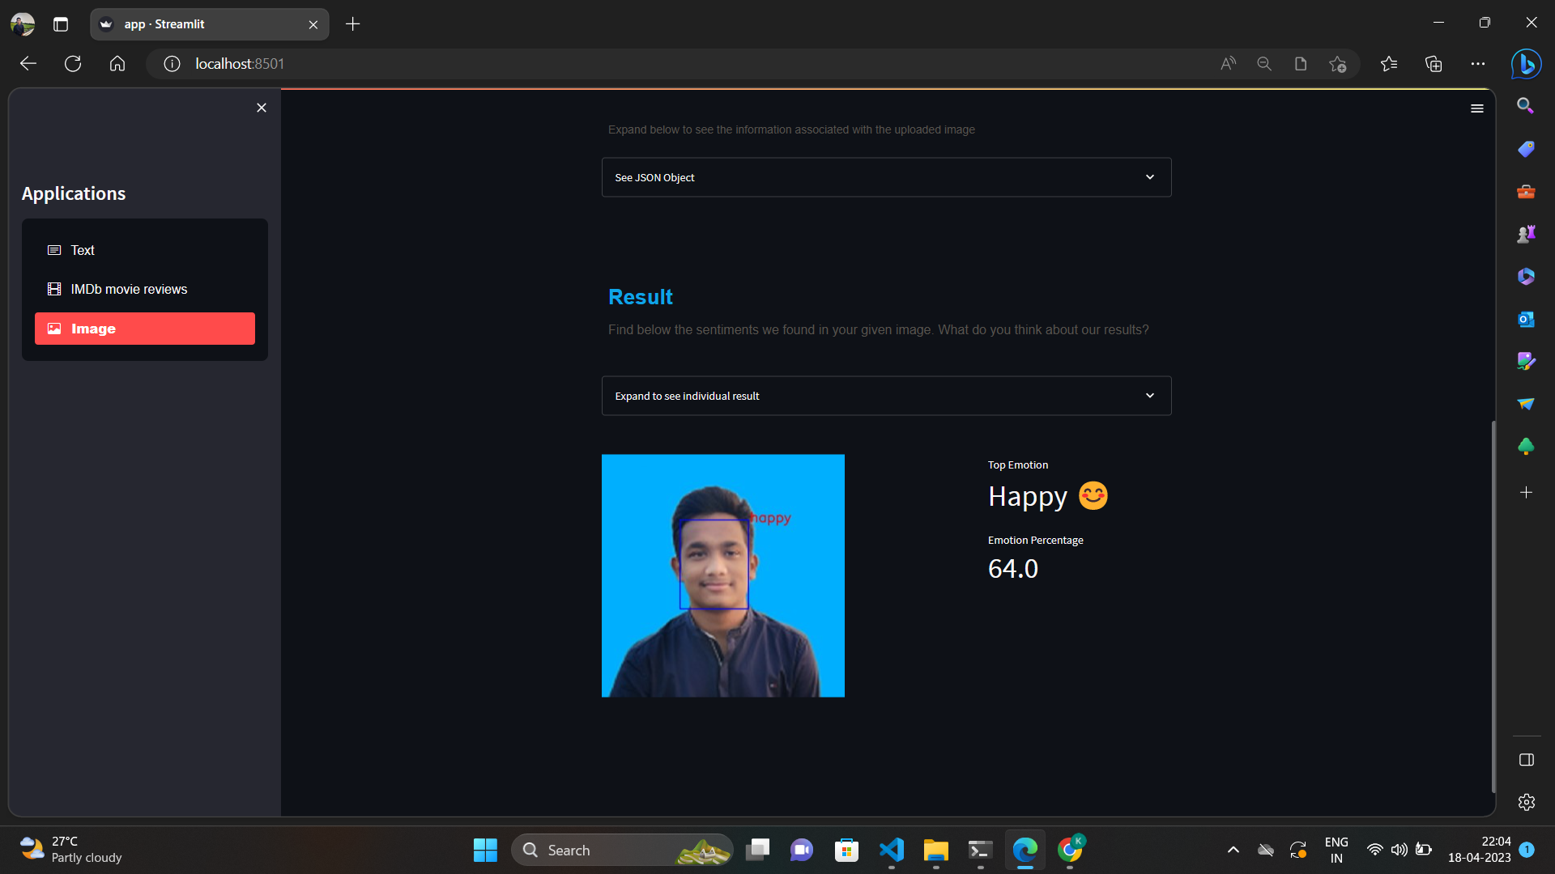

Slide 15
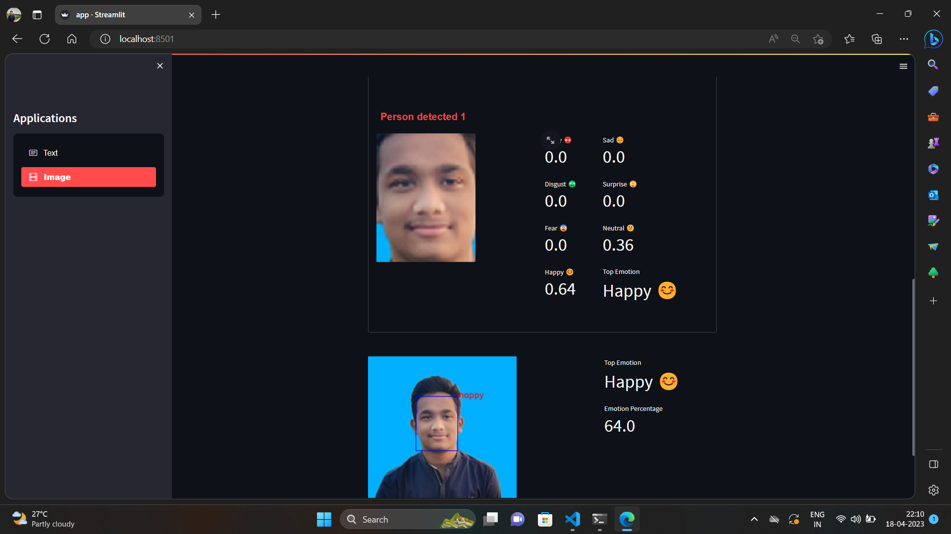

Slide 16
Live Emotion
Detector

Slide 17
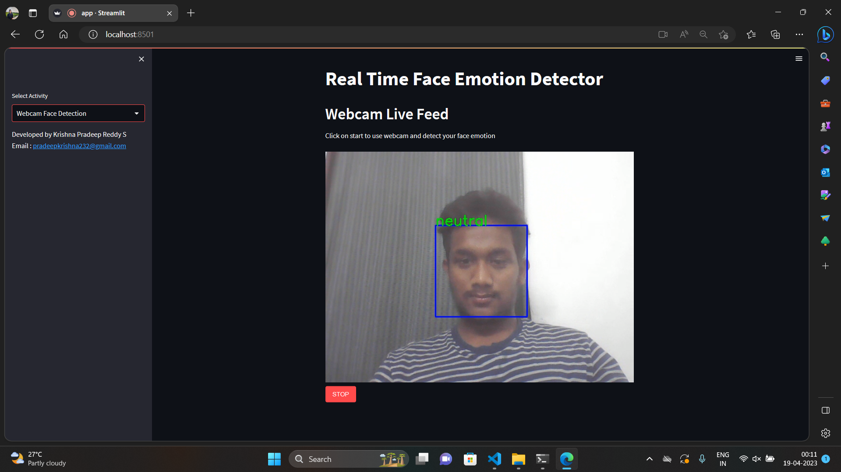

Slide 18
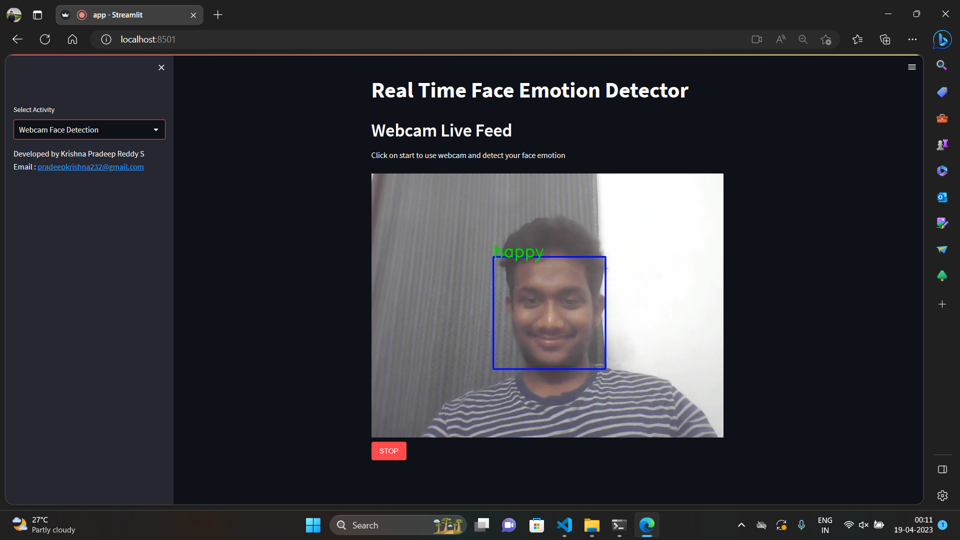
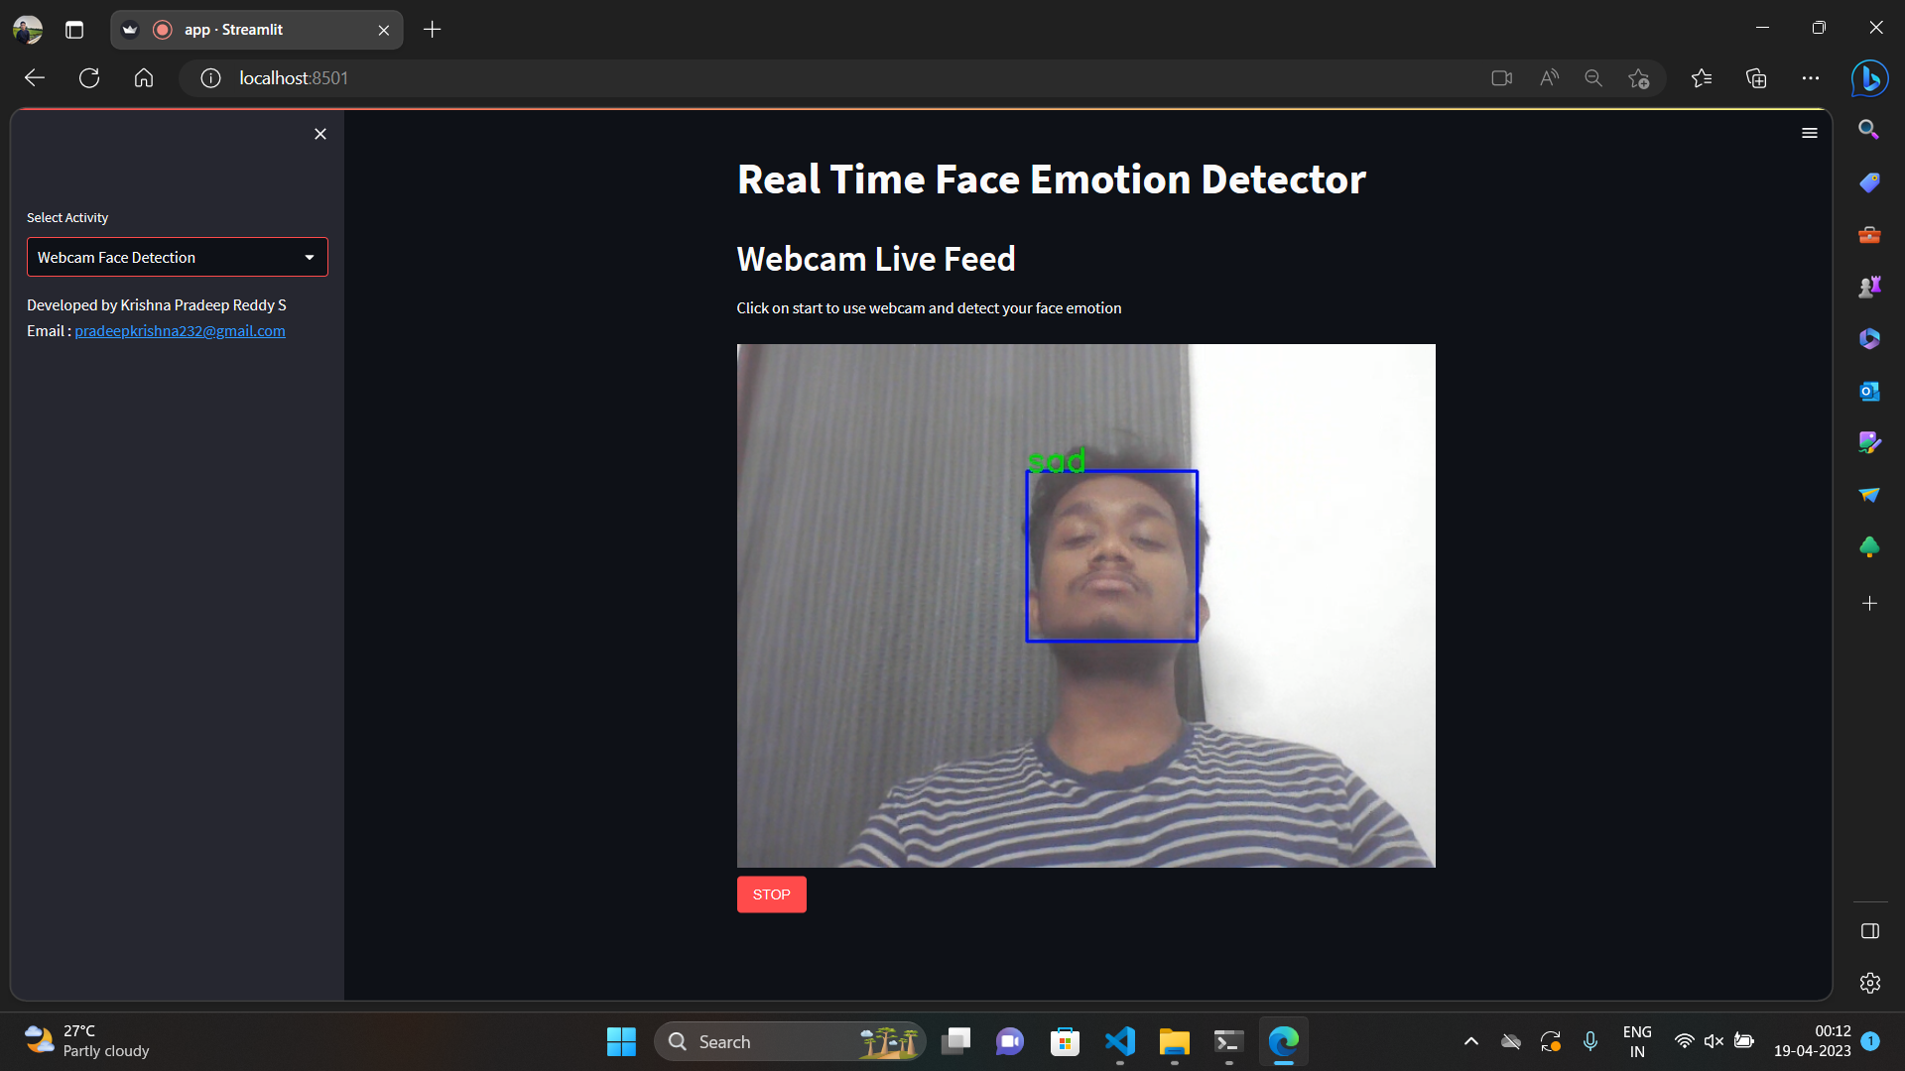

Slide 19
Timeline
Emotion detection
WebCam
Detect emotion in text & faces in Images
Detection of emotion through live webcam
1
2
3
4
Image to text
Application
Extracting text from images to classify comments in social media
An Integrated application

Slide 20
"Emotion is the force of life, the power of thought, the storm of will, the breath of emotion, the war of love; it is the vitality of action, the joy of existence, the source of wonder, the fountain of laughter, the music of the soul."
FEELING WORDS

Slide 21
CONTRIBUTOR
KRISHNA PRADEEP REDDY S
RA2011047010018

Slide 22
THANKYOU

